Slide 1
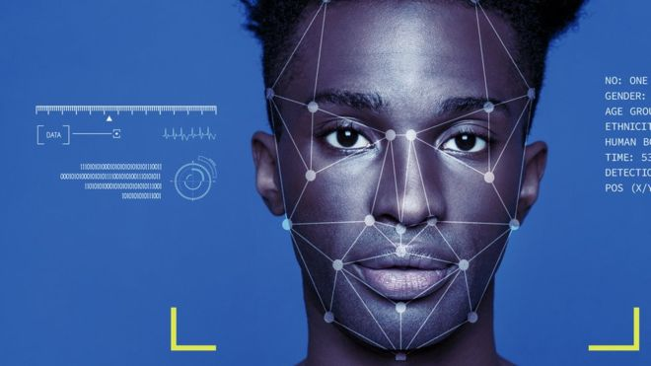
Face Detection
Artificial intelligence Lab
cse-418

Slide 2
Team members
Tonmoy sarker (161412347)
Md manwar (161412323)
Saiful islam (161412322)
Shamim al mamun (161412340)

Slide 3
Contents:
• Objectives
•What is Face Detection?
•Face detection and Recognition
•Why we chose Face Detection Project?
•Methodology
•Limitation
•Future Plan

Slide 4
Objectives
Survey major face detection works
Future research directions

Slide 5
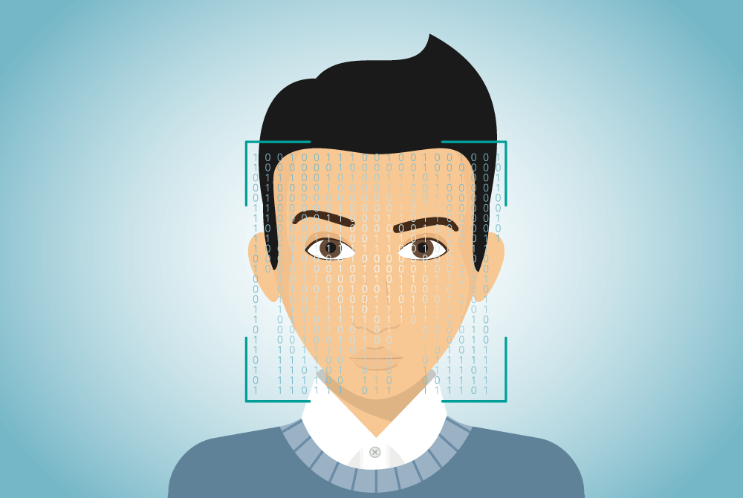
What is Face Detection?
Face detection is a computer technology being used in a variety of applications that identifies human faces in digital images.
It detects facial features and ignores anything else, such as buildings, trees and bodies.

Slide 6
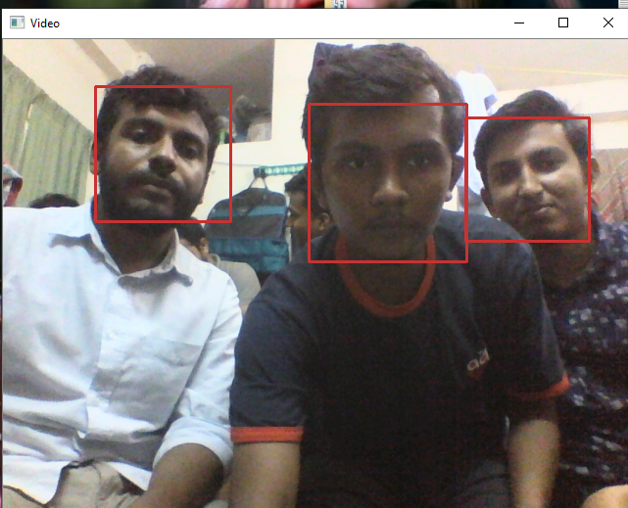
Face detection and Recognition
Face detection is a broader term than face recognition. Face detection just means that a system is able to identify that there is a human face present in an image or video or real time.
Face detection has several applications, only one of which is facial recognition.

Slide 7
Why face detection
It goes with modern era such as while we an unlock a device like mobile phone .
security maintenance
Not common like java

Slide 8
Methodology
Requirement tools:
OpenCV
Python IDLE
Laptop(with web cam)

Slide 9
Methodology
Face detection is performed by using classifiers. A classier is essentially an algorithm that decides whether a given image is positive(face) or negative(not a face). A classier needs to be trained on thousands of images
with and without faces.
Fortunately, OpenCV already have pre-trained
face detection classifiers, which can be used in our program.
The two classifiers are:
Haar Classier and
Local Binary Pattern(LBP) classier.
In our project, we use the haarcascade_frontalface.

Slide 10
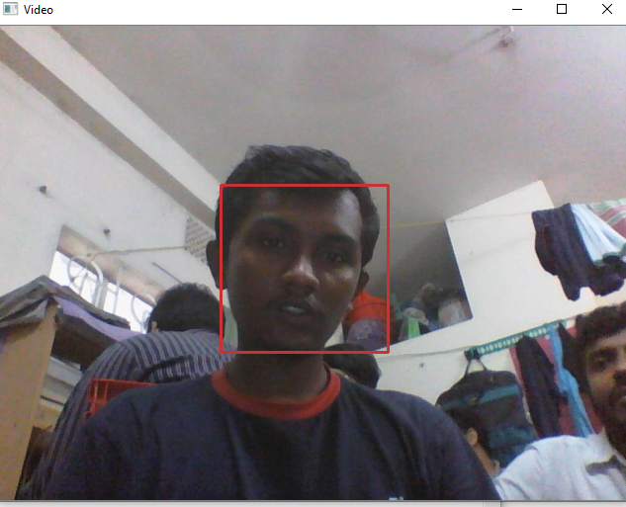
Limitation
Our project cannot detect the faces accurately in low light

Slide 11
Future Plan
Our project can only detect the faces. Not find out the matched faces that stored in the dataset. So we will try to do that in future.

Slide 12
Thank you

